Slide 1
Kubernetes Architecture

Slide 3


Slide 4
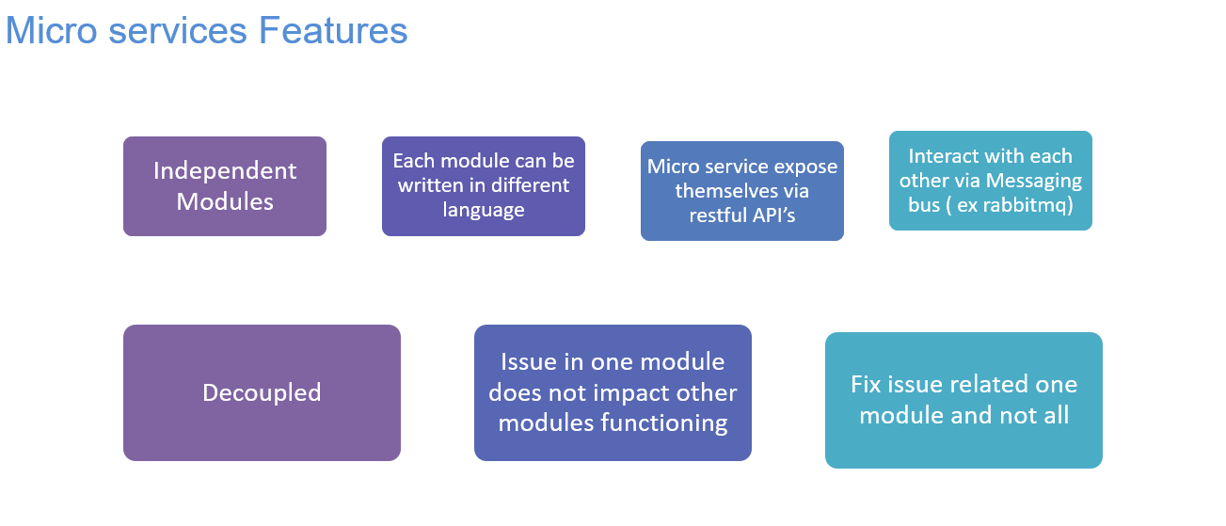

Slide 5
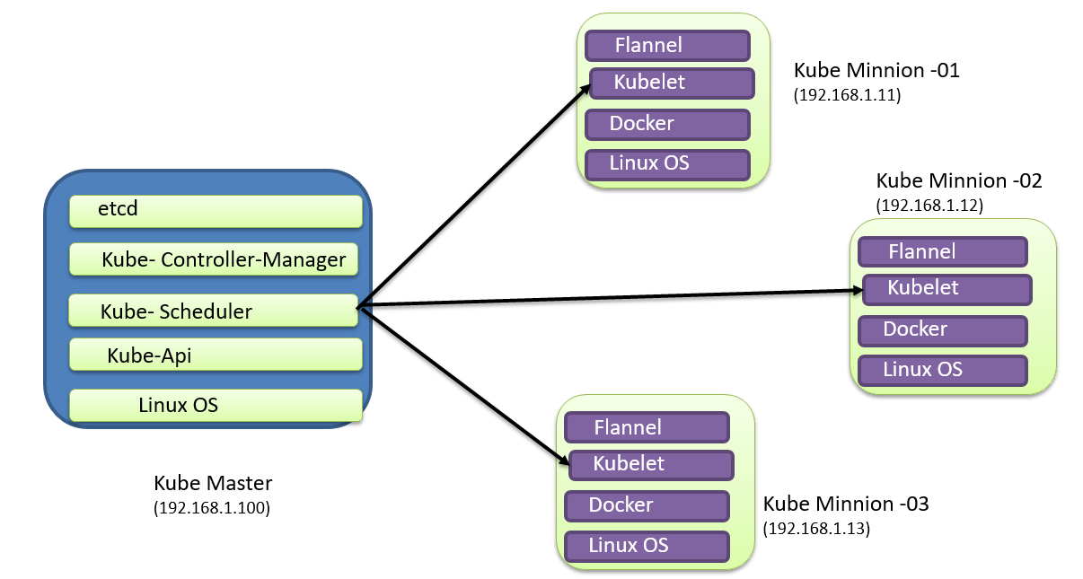

Slide 6
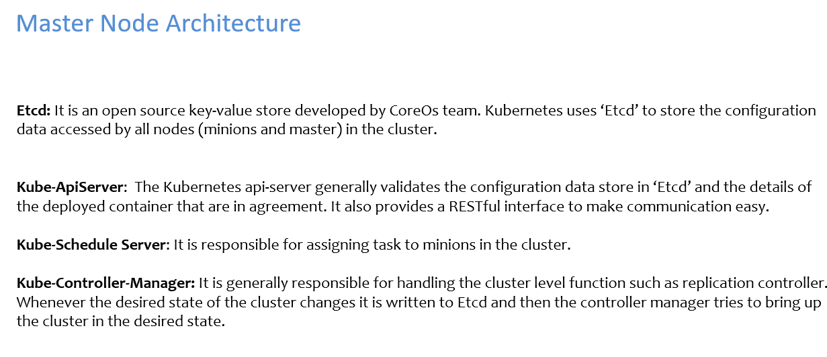

Slide 7
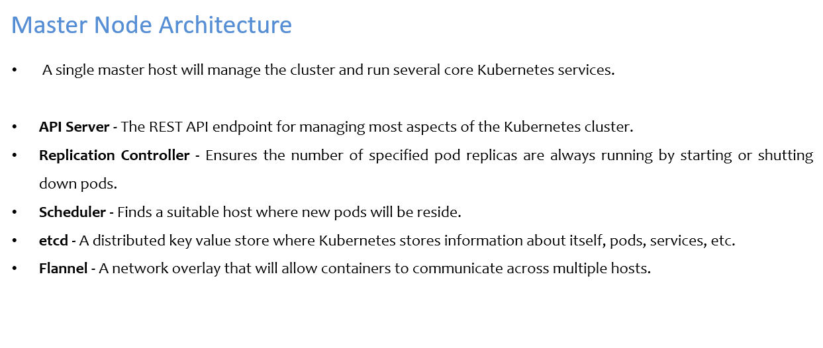

Slide 8
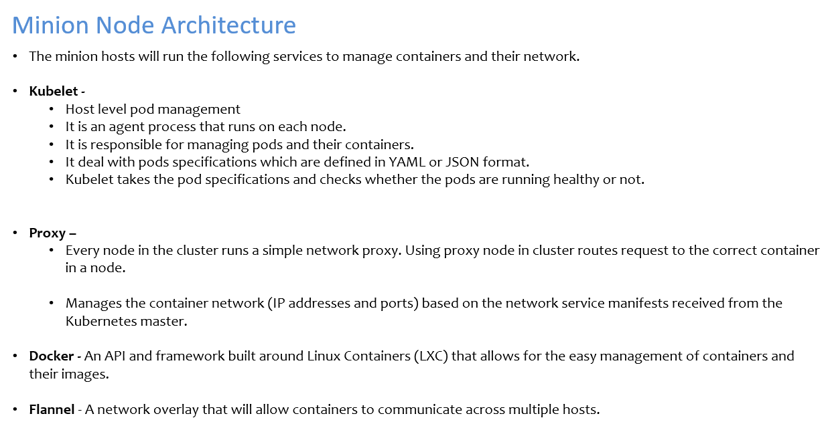

Slide 9
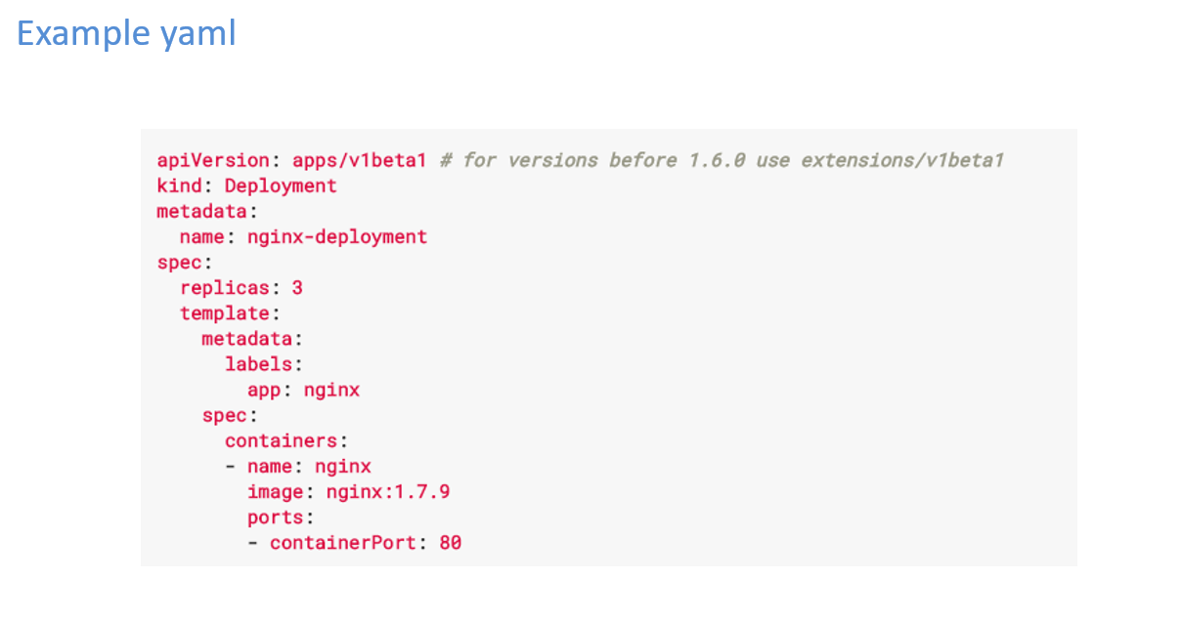

Slide 10
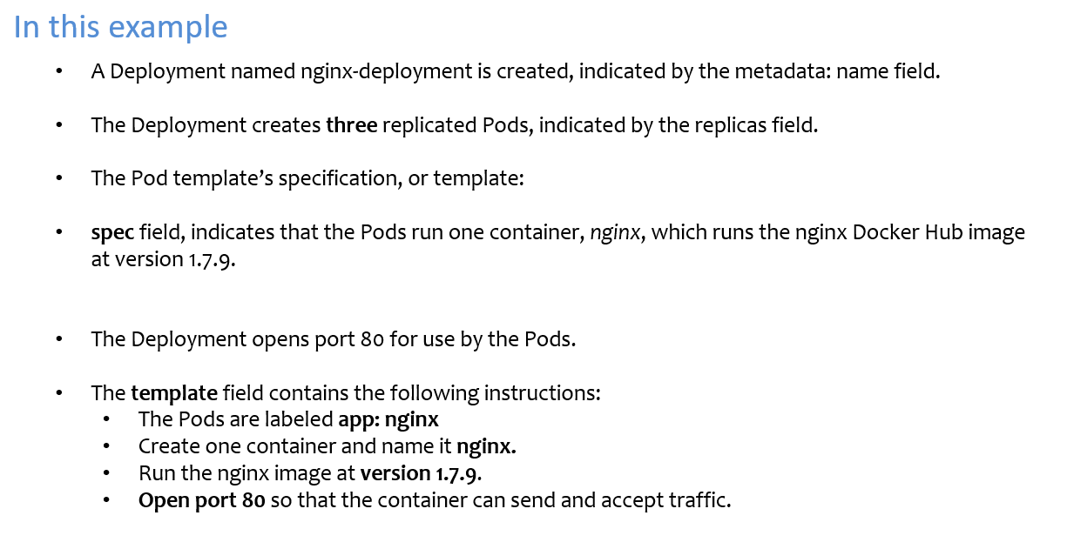

Slide 11
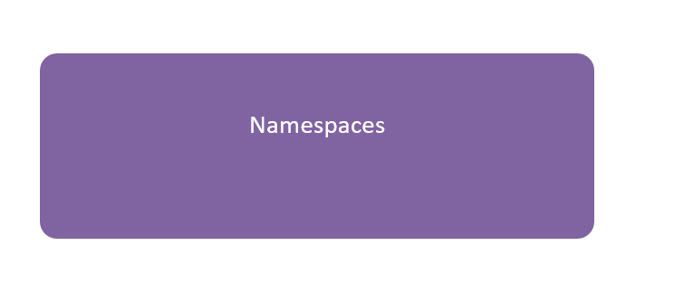

Slide 12
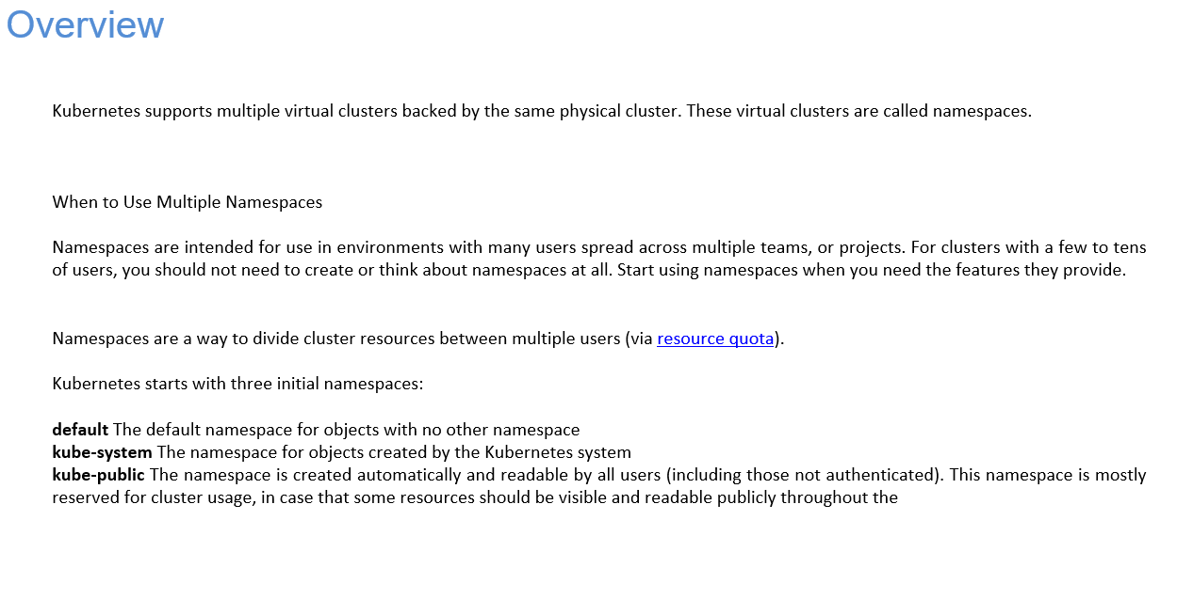

Slide 13
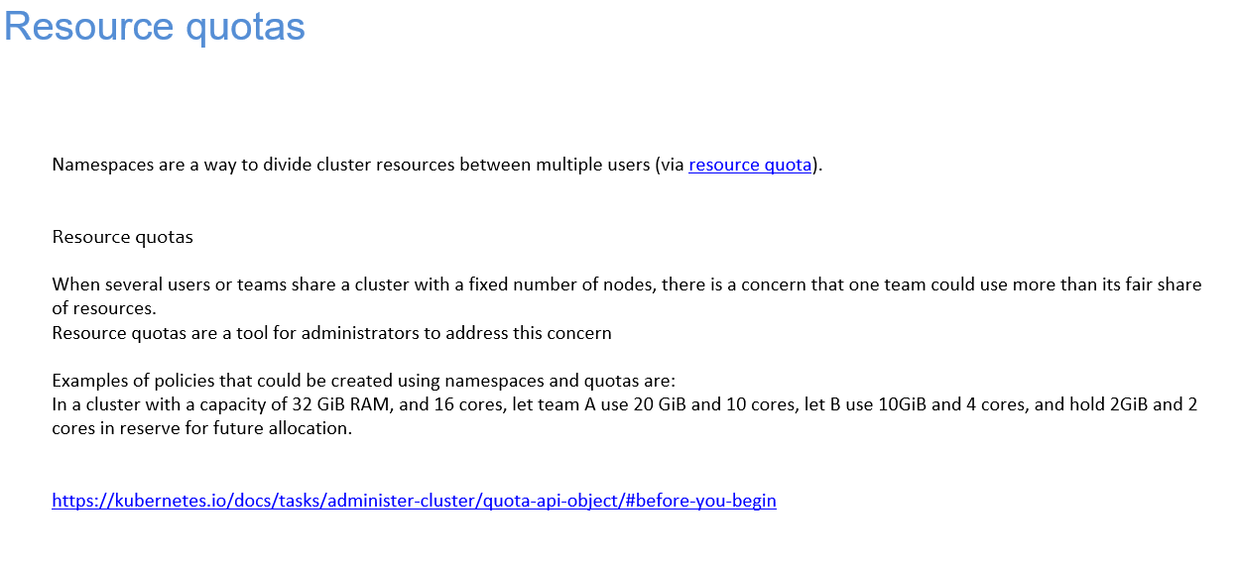

Slide 14
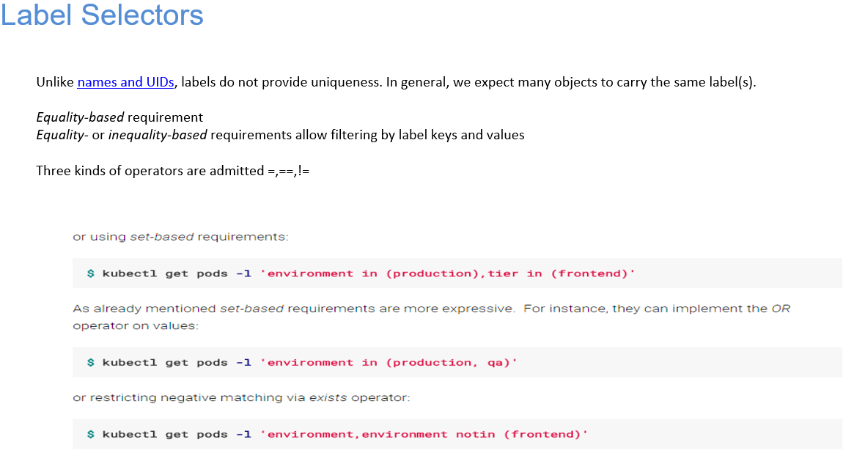

Slide 15
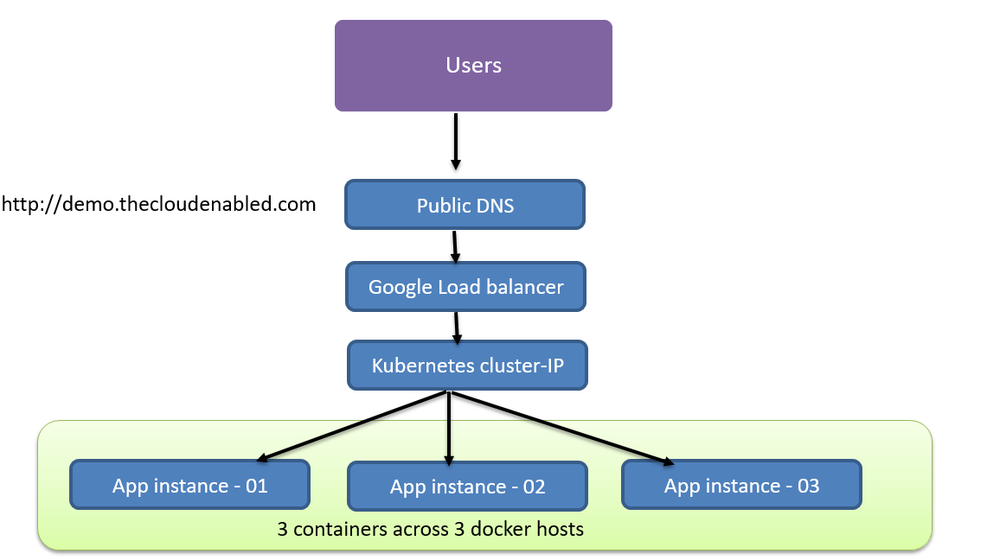

Slide 16
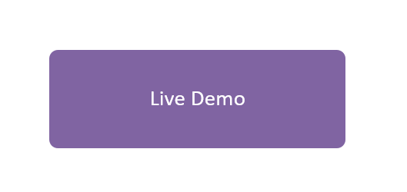

Slide 17
Thank You

Slide 18


For more course enquiries, visit us at:
Branches / Sales Centres
NTUC LHUB @ NTUC Trade Union House, 73 Bras Basah Road, #02-01, S189556
NTUC LHUB @ Devan Nair Institute, 80 Jurong East Street 21, #02-03, S609607
NTUC LHUB @ Lifelong Learning Institute, 11 Eunos Road 8, #05-01, S40860
NTUC LHUB @ Tampines Mall, 4 Tampines Central 5 (L4, outside Long John Silver’s), S529510
NTUC LHUB @ AMK Hub, 53 Ang Mo Kio Ave 3, #B1-80, S569933
NTUC LHUB @ NorthPoint City, North Wing, #B1-39, 930 Yishun Ave 2, S769098
NTUC LHUB @ Causeway Point, 1 Woodlands Square, #03-K03, S738099
NTUC LHUB @ Compass One, 1 Sengkang Square, #04-23, S545078
NTUC LHUB @ Jurong Point 2, 1 Jurong West Central 2, #03-119, S648886
Training Centres
NTUC LHUB Industry Skills Centre @ Benoi, 60 Benoi Road, #01-08, S629906
NTUC LHUB @ Aljunied Training Centre, 260 Sims Ave, ECM Building, #02-01, S387604
NTUC LHUB @ Tampines Plaza 2, Tampines Plaza, 5 Tampines Central 1, #04-02, S529541
6336 5482
www.ntuclearninghub.com
Notes:
Website
www.ntuclearninghub.com

